Slide 1
Enterprise Information Security: Key Threats and Remedies
Koshman Anasteysha
Iu8-51

Slide 2


Introduction: what information security is and why systems are so important

Slide 3

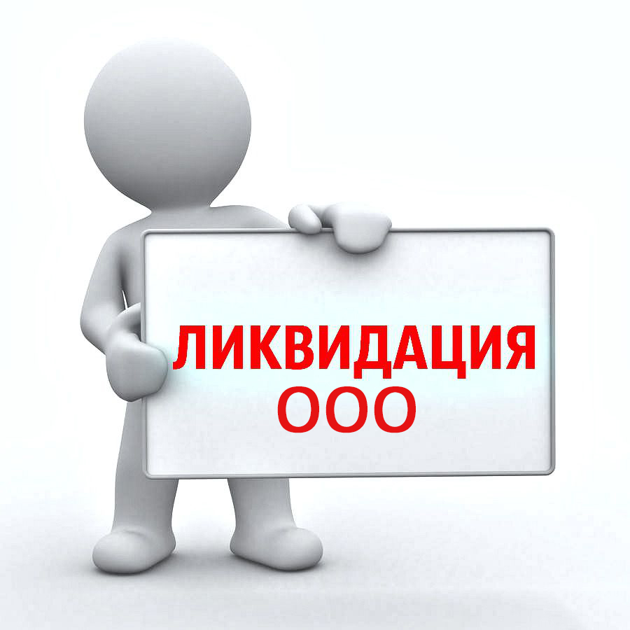
significant financial losses
complete liquidation

Slide 4
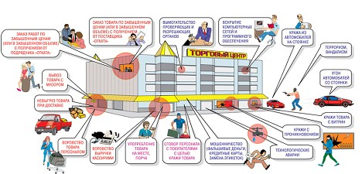
Actual types of information security threats

Slide 5

1. Inattention and negligence of employees

Slide 6
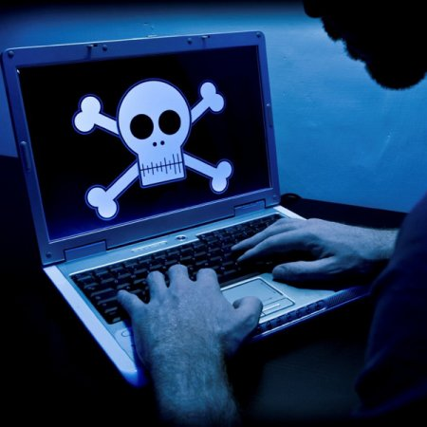
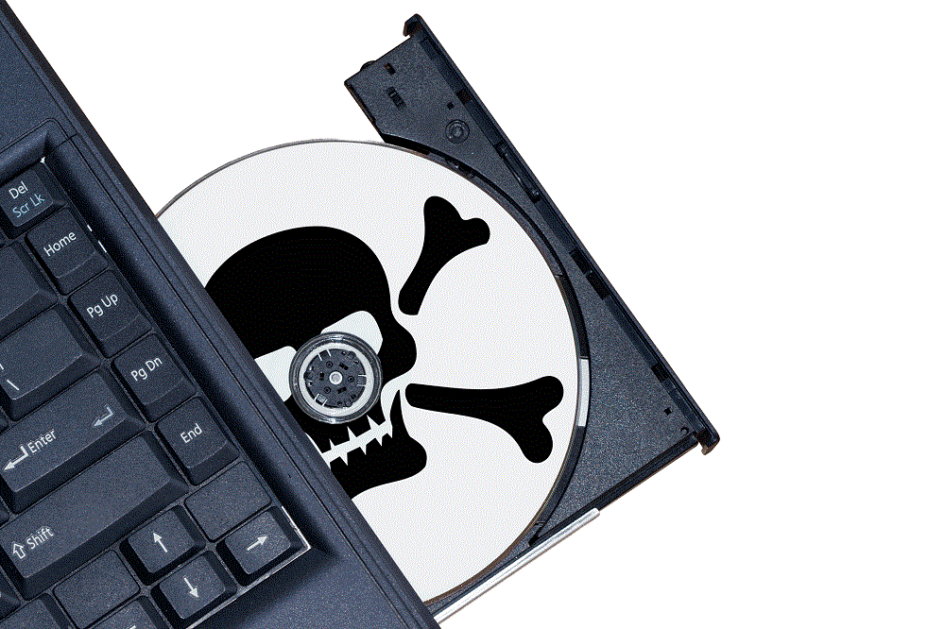
2. Using pirated software

Slide 7
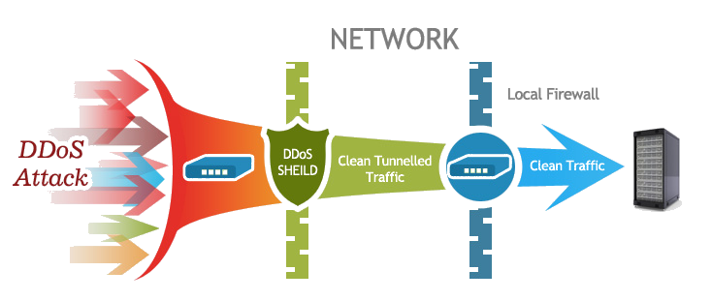
3. DDoS attacks

Slide 8

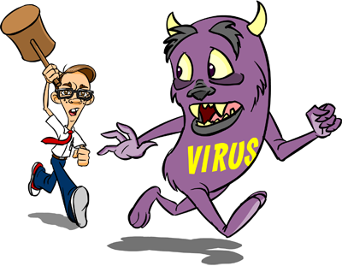
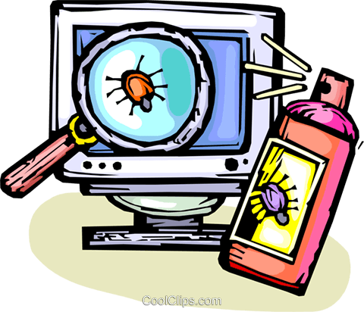
4. Viruses

Slide 9


5. Threats from business co-owners

Slide 10


6. Legislative peripetia

Slide 11

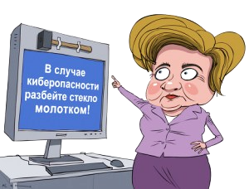
Information Security Methods
in case of a safety hazard, break the glass with a hammer

Slide 12
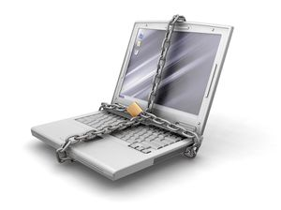
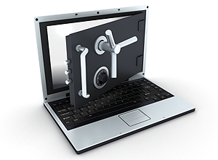
1. Physical means of protecting information

Slide 13


2. Basic means of protecting electronic information

Slide 14

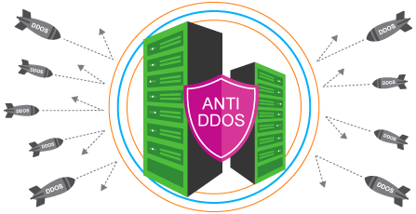
3. Anti-DDoS

Slide 15
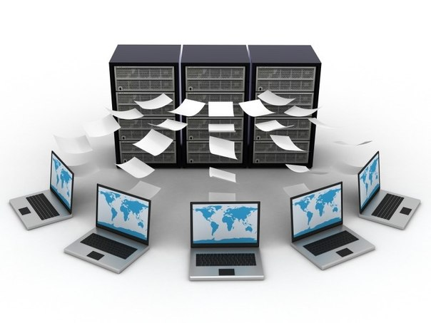

4. Data backup

Slide 16
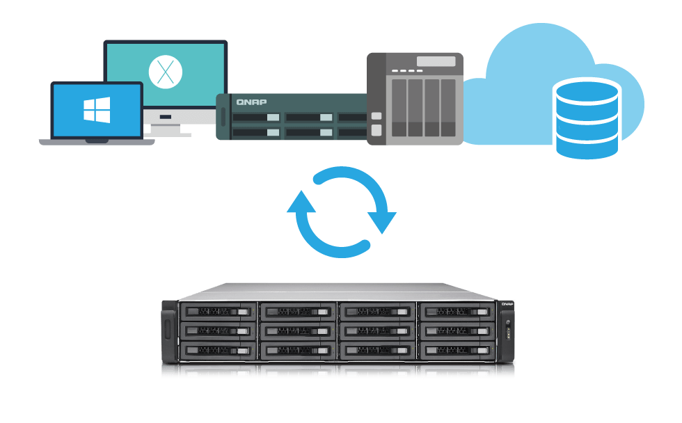

5. Disaster Recovery Plan

Slide 17
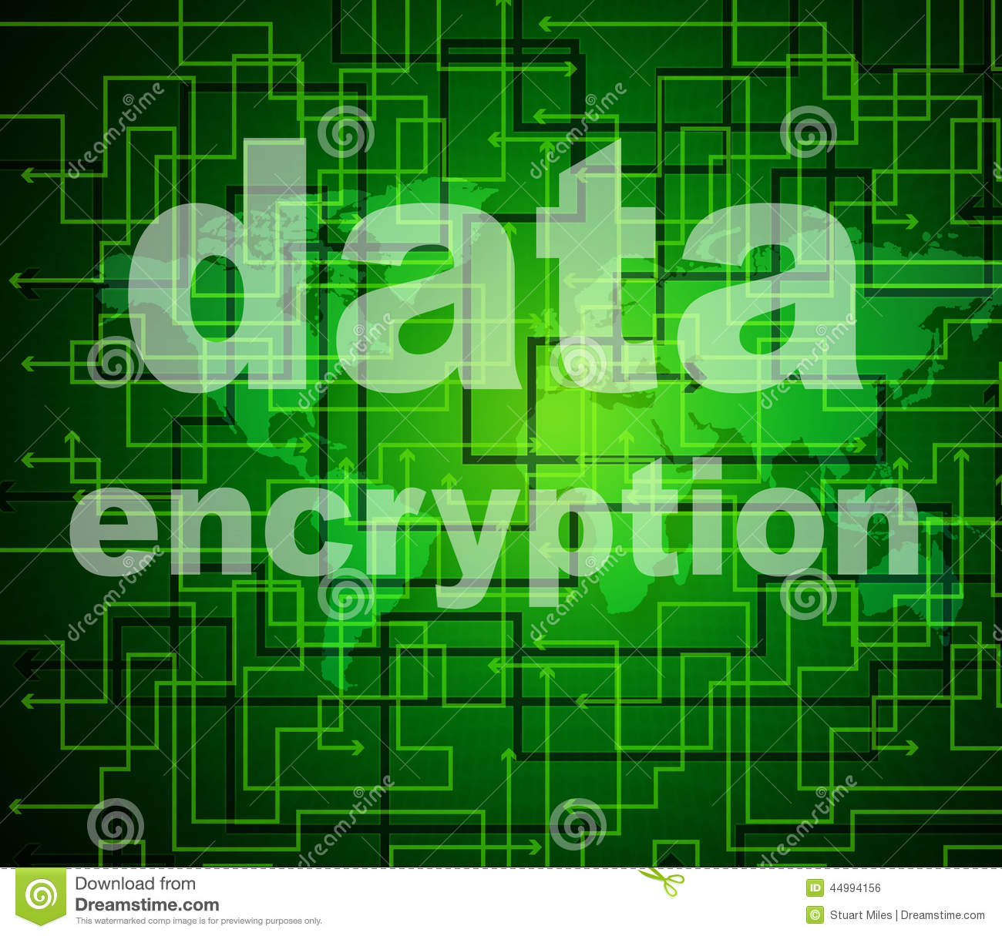

6. Data encryption when transferring information in electronic format (end-to-end protection)

Slide 18

Conclusion

